Slide 1






Peer-to-Peer Lending
&
Stock-Trading Apps
Workshop #3
/UoGfintech
@UoGfintech
@uogfintech
UoG FinTech Society

Slide 2
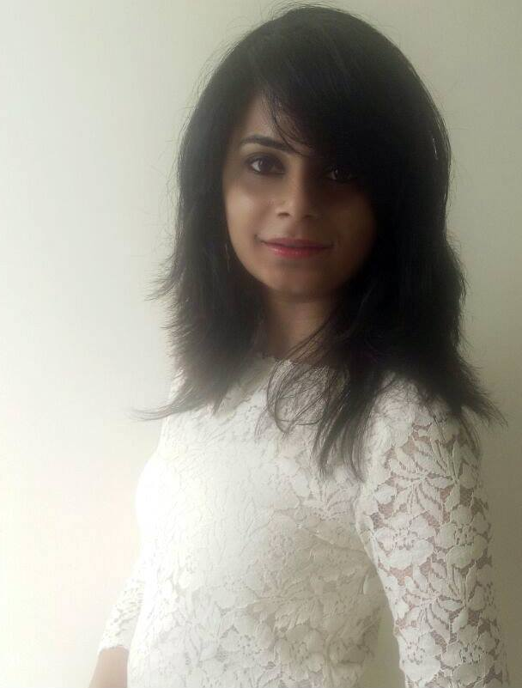


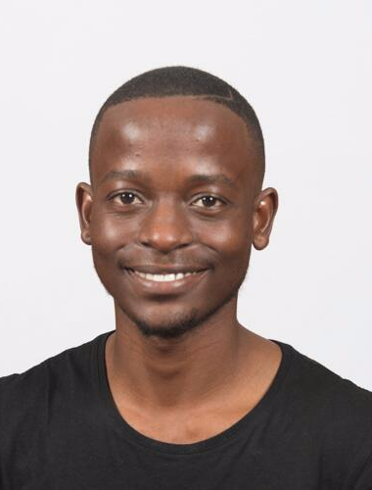
Our Team
Heli Trivedi
George Pergeris
MSc Banking and Financial Services
MSc Financial Risk Management
Elisabetta Trasatti
Amantle Khachana
M.A. Economics
B.Acc. Accounting & Finance

Slide 3

Peer to Peer
Lending

Slide 4







P2P Lending: What is it?
“Debt financing without the middle-man & on an online platform”

Slide 5
How does it work?
1. Registration and provision of important documents, such as identification documents, physical address, bank details of both parties etc.
2. Borrowers initiate the process by giving additional information about the loan amount and purpose.
3. The P2P platform matches the borrower with the ideal lender. The loan is issued to the borrower.

Slide 6
What makes P2P different?
$6.6 billion
In 2015 alone, the P2P industry generated $6.6 billion in loans.
48.2%
The P2P lending market valuation will reach US$897.85 billion by 2024, as it expands at a significant Compound Annual Growth Rate (CAGR) of 48.2% from 2016 to 2024 .
Savings.
Low overheads, emerging technologies and algorithms allow for a cheaper business model were savings are passed on to borrowers.

Slide 7
Pros & Cons
Lender
Borrower
Higher rates of return
Risk diversification
Greater choice
Personal saving account
Ease of access to money
Transparency
Competitive interest rates
No pre-payment penalty
Fast loans
Convenience
Boosts credit score
Money is at risk
Interest is not tax free
Cash not always lent immediately
Time constraints
Bad credit = high interest rates
Lack of discretion
Borrowers fees
Liability
Borrower
Lender

Slide 8
Regulation
UK
China
Other
Rest of the world
FCA and FCSCS
Variety of regulations
Securities Commission in region
Lack of reliable data

Slide 9
Peer-to-peer Lending - Timeline
2007-2008
2006
2011
2012
Financial Crisis
2056
Lending Club
2010
SoFi
Upstart
Prosper
Peerform
>
Notes:
Add your own dates and event details to the flag markers. Move the flags along the timeline to match your event dates. Copy and paste a flag to add more.

Slide 10
First Issue
From individual lenders to marketplace lending
Institutional investors

Slide 11
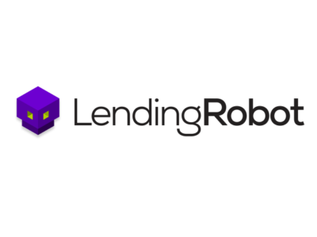
Second Issue
Third-party investing tools
Lending Robot is now partner of Lending Club
Orchard collects information from multiple platforms “much the way Amazon aggregates independent merchants”

Slide 12
Do these issues compromise the idea of disintermediation?

Slide 13
Applications in Emerging Markets
Asia
Mongolia:
Startup: AND Global
Increase of financial inclusion in rural areas
Latin America
Argentina and Peru:
Startup: Afluenta
Alternative to long bureaucratic procedures
Africa
Growth especially in loans for businesses: from 2$ million in 2014 to 14$ in 2015

Slide 14


Emerging markets
AND Global
Mongolia’s highest-valued tech start up
Mobile app LendMN for credit scoring
Founders’ main aim: offer an accessible alternative to “loan sharks”

Slide 15
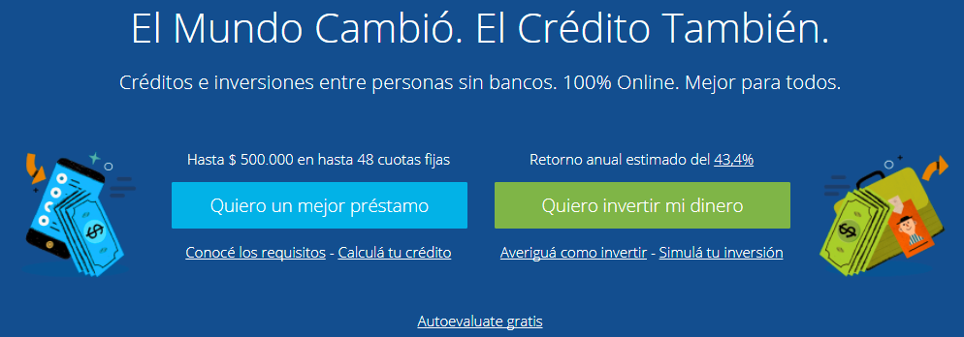
Emerging markets
Afluenta
Launched in 2012 in Argentina, expanded in Peru in 2015
Addresses problem of long bureaucratic procedures
Economic and social impact

Slide 16
Stock trading
Apps

Slide 17
Electronic Trading – what it is?
Stock, derivative and security trading without the use of phone
Users – Buyers and sellers - are connected with I.T systems automatically
Extensions to mobile applications allow for trading on the go
Real time quotes, buy/sell, portfolio managing , alerting
notifications

Slide 18
Notable Characteristics
1
Fast and efficient
3
Intuitive interfaces
2
Real-time stock alerts
4
Confidence booster

Slide 19
Pros & Cons
High risk for new investors since the acquire wrong confidence and could lead to high losses
No brokers Needed
Low fees
Pros
Cons
Training sessions are usually provided for education purposes
No financial minimum
Tools for self – education
Cybersecurity issues

Slide 20
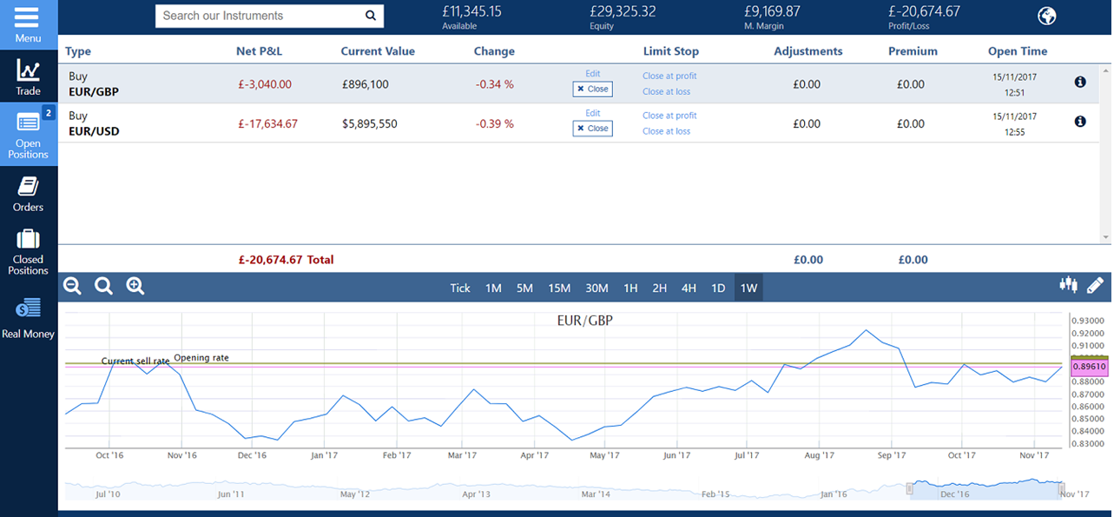

Slide 21
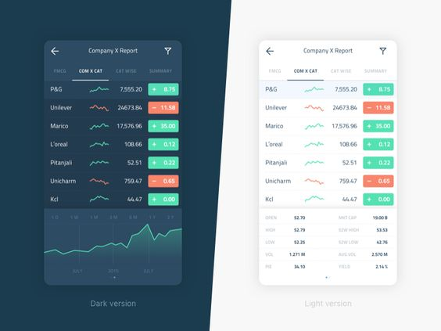




Popular applications and their functions
Robinhood
Trading 212
TD Ameritrade
E*Trade Mobile

Slide 22
The future of the industry
1
3
Analysis of the unstructured data
Instant Access, Instant Information
2
4
Robo-advisors
Increased transparency

Slide 23
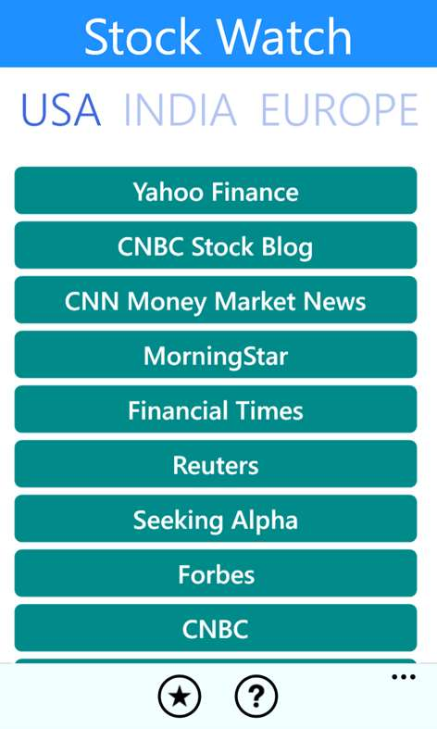

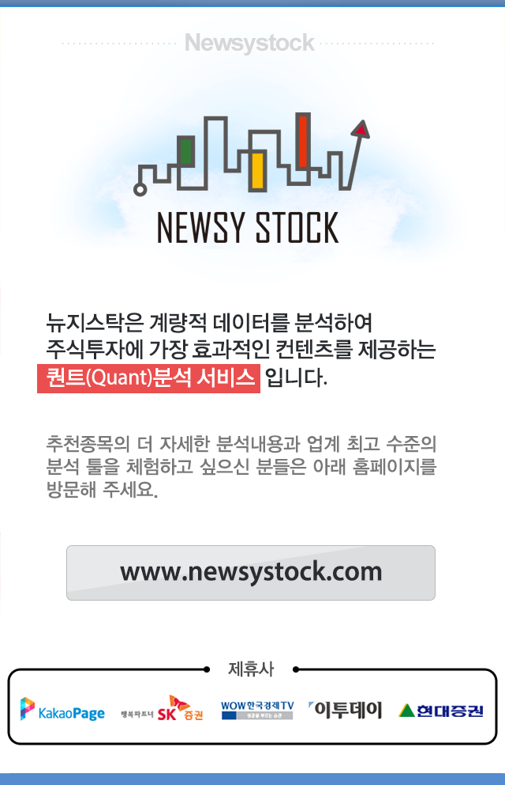
Different applications in the emerging markets and in different geographies
India
China
South Korea
Stock Watch
Chaojiaoyi
Newsystock

Slide 24

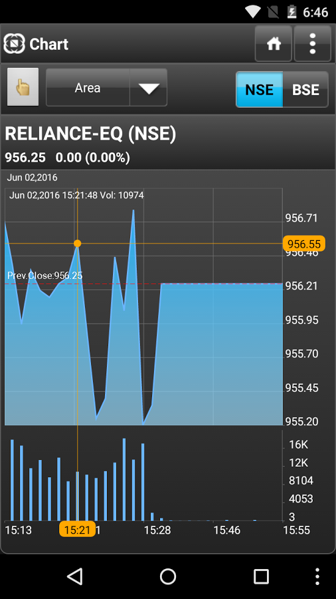
Conclusion
Revolutionized the process
Democratized the system
Never miss the opportunity

Slide 25
Guest Speaker
Cybersecurity & FinTech specialist
Greig Paul

Slide 26
Glasgow University FinTech Society
Plans for Semester 2 & How to get involved

Slide 27

Our plans for Semester 2
Workshops:
Artificial Intelligence (AI) – end-January
Ethics & Regulations – mid-February
Lab tutorial:
Algorithmic trading – early-March
Applied FinTech Project with a real-world organisation – semester-long (to be confirmed)
ASBS’s panel event with speakers from FinTech space (7th February)

Slide 28
Workshops
Each workshop run by group of 4-5 students who express interest in the given topic.
Stages:
The workshop team engages in a research about the specific FinTech topic. (Artificial Intelligence / Ethics & Regulations)
The team prepares a (1) Report and (2) Presentation slides based on the report
The team delivers a presentation on the day of the workshop
Furthermore, a guest speaker is invited to the workshop to provide additional perspective on the topic.

Slide 29
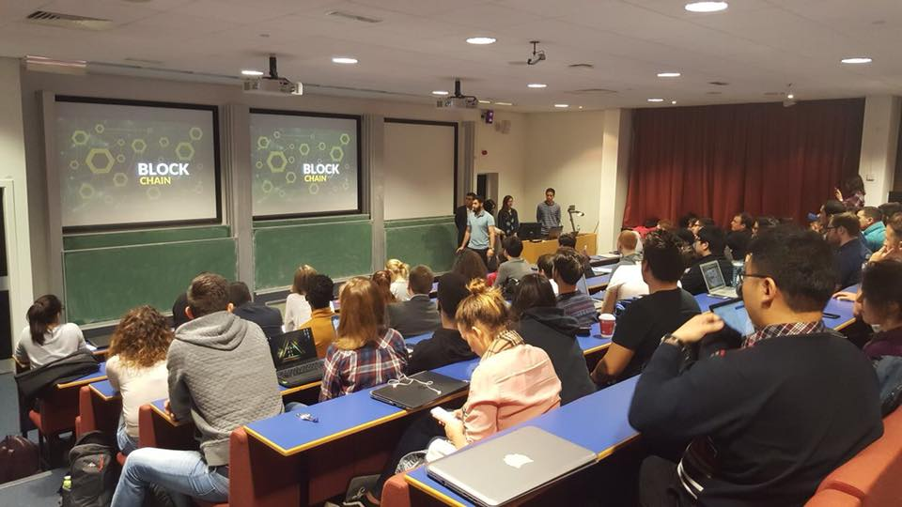
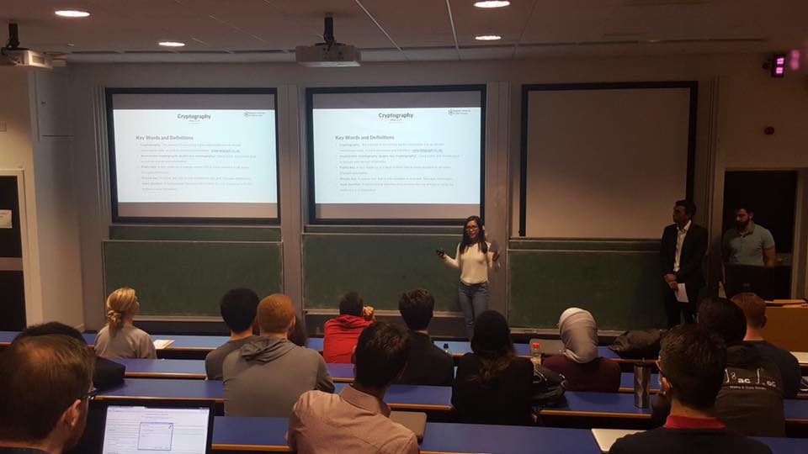
Feedback on our workshops
“I can honestly say that I was bowled over by the prep done by the team. Usually these type of events just invite a speaker and then sit back to listen/learn etc. In this case, it was clear that they'd not only worked hard in advance to get their heads around the subject but to also then prepare a handout to share with the rest of the group was really impressive!”
Dug Campbell Blockchain Consultant, Writer and Speaker
"You should all be very proud of what you have achieved in such a short amount of time, UoG FinTech Society is shaping up to be a fantastic and professional student organisation. It's pleasure to work with you all".
Katie Forsyth Alumni Officer - Adam Smith Business School

Slide 30
Lab
Topic: Algorithmic trading
Aim: to develop technical skills among society members
No prior knowledge of programming is required.
Applied FinTech Project
Idea: The FinTech Society project team works on a project aimed at solving specific FinTech-related issues in existing businesses, e.g. to map out challenges and opportunities faced by the businesses with regards to FinTech.
Objective: to provide a business with the team’s insights and recommendations on the given FinTech issue.
Business Partner: TBD. More info coming soon!

Slide 31
Want to get involved?
We are looking for members into our new workshop teams!
Artificial Intelligence (AI) workshop – end-January
Ethics & Regulations workshop – mid-February
How you will benefit?
Deepening you knowledge of FinTech – something increasingly sought after by employers!
Developing your analytical and research skills
Perfecting your communication and presentation skills
Demonstrating responsibility by collaborating in team
Developing an ability to explain complex ideas in easy terms
Enhancing your CV by making a real contribution to the society work

Slide 32
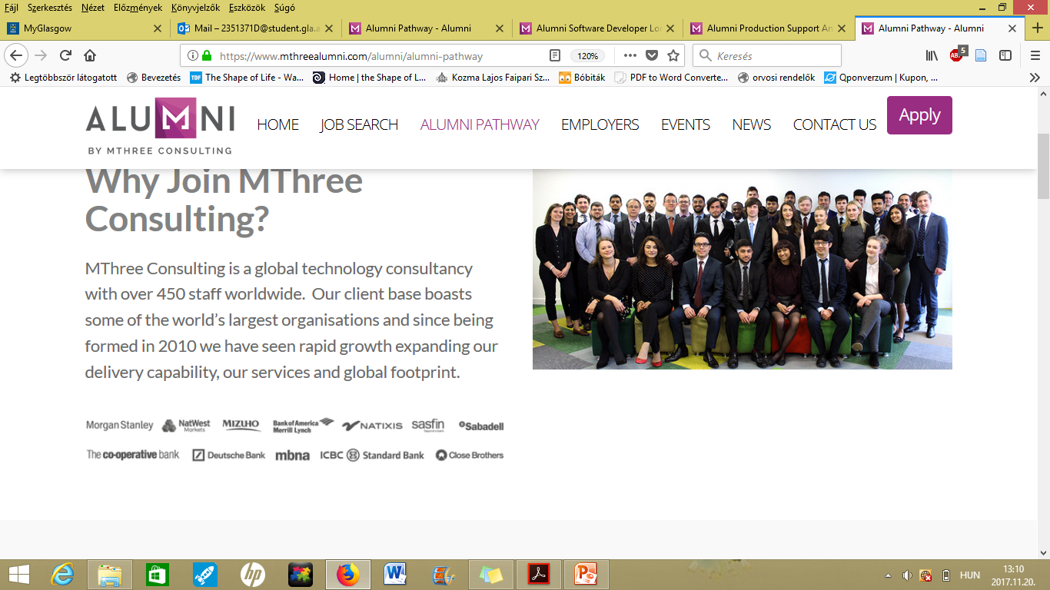

MThree Graduate & Internship programmes 2018
MThree: a global technology & business consultancy
Looking for students graduating in Computer Science, Mathematics, Physics or Engineering
Benefits include:
At least 4 weeks paid training or 10 week paid summer Internship
Work in a technology environment in a global Investment bank
Technical Business Analyst
Software Developer
Information & Cyber Security Analyst
Production Support Analyst
Register your interest on https://goo.gl/forms/ZTUrCQn4skT1UgOg1 or contact me, Tamás Drexler (dretom93@gmail.com ) ☺

